Slide 1


Performance Modeling Framework for SLO-Driven MapReduce Environments
Abhishek Verma, Ludmila Cherkasova,
Roy H. Campbell

Slide 2

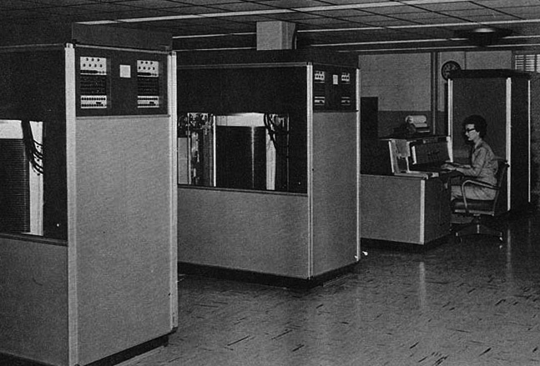
Exponential increase in disk capacity*
$50 ~ 500GB
$5000 ~ 25MB
Exponential decrease in $/GB
Throughput has flattened
*Source: http://ns1758.ca/winch/winchest.html
Notes:
The last 30 years have seen an exponential increase in disk capacities. At the same time, there has been an exponential decrease in $/GB. In 1980, $5000 would buy you about 5MB. Today, you can get a 500GB hard drive for $50. However, the disk bandwidths have not improved in the same proportion. The throughput has flattened from a few KBs per second to 100s of MBps.

Slide 3





Big Data in the Cloud
Exponential decrease in $/GB
Store all data
Web companies, organizations, sensors
Unreasonable effectiveness of data*
Extract information out of raw data
Gain insights into user behavior
Ad targeting
Recommendation algorithms
Optimize supply chain
*Alon Halevy, Peter Norvig, Fernando Pereira, "The Unreasonable Effectiveness of Data,"
IEEE Intelligent Systems, pp. 8-12, March/April, 2009
Notes:
A consequence of the exponential decrease in $/GB is that we can now store all our data. No bit of information has to be ever discarded. This data deluge has enabled new kinds of applications for web companies, organizations and sensors. Peter Norvig and others at Google wrote a paper about the unreasonable effectiveness of data: Very simple models trained on orders of magnitude more data are much more effective than complicated models trained on a limited set of data. This has enabled new tools like statistical machine translation.
More than 99.99% of stored data is never going to be observed by a human. Hence, it has become critical to mine useful information from raw data. Collected data is being used to gain insights into user behavior for ad targeting like Google or recommendation algorithms like Netflix. It is also being used for optimizing supply chain for example by Walmart or Amazon.

Slide 4

Big Data Enablers
Disk throughput has flattened
Use multiple disks in parallel
Large scale datacenters
Commodity hardware
cheap
unreliable
Programming models
MapReduce, Dryad, DryadLINQ
Pregel, Spark
Notes:
Because of the flattening of the disk throughputs, in order to achieve high aggregate throughput, a large number of disks have to be used in parallel. Large scale data centers are being built by Google, Microsoft, Amazon all over the world. Commodity hardware is used since it is cheap, but it is also unreliable. Several programming models have been proposed to hide the complexities of using these large number of machines and tolerate failures. MapReduce is one such popular programming model that is being used by Google, Yahoo!, Facebook, LinkedIn, etc. More general models like Dryad, DryadLINQ have been proposed. Other frameworks have been proposed for more specific applications like Pregel for Graph processing and Spark for in-memory iterative computations.
With the advent of MapReduce paradigm, there are new requirements from its users. Here is a quote from a paper from Yahoo!

Slide 5

User Wish-list
When will my job complete?
How many resources should I give to the job
if I want to process x amount of data
want to get results within y time
What will happen if machines fail during execution?
How fast will my jobs run on a different hardware?

Slide 6

Quote*
“would like to move to a model that is based on (soft) deadlines rather than the low-level mechanism of bounding the queue time.
However, a deadline-based model hinging on the ability to model Pig/Hadoop execution times in a multi-tenant environment, is elusive.”
*Olston et. al., “Nova: Continuous Pig/Hadoop Workﬂows”. SIGMOD 2011.

Slide 7
Service Level Objectives (SLO)
Performance prediction
Resource provisioning
Capacity planning
Comparing different alternatives
Empower cloud users and providers

Slide 8

Thesis
Performance modeling
of MapReduce environments
through a combination of measurement, simulation, and analytical modeling
for enabling different service level objectives
is feasible, novel, and useful.

Slide 9

Roadmap
Challenges
Performance Modeling Tools
Applications
Evaluation
Related Work
Summary and Future Work

Slide 10
Roadmap
Challenges
Performance Modeling Tools
Evaluation
Applications
Evaluation
Related Work
Summary and Future Work

Slide 11


Slide 12
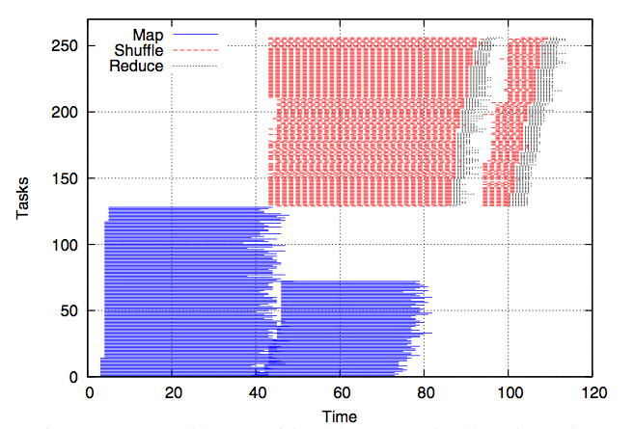
Why is Performance Modeling Difficult?
WordCount with 128 map/128 reduce slots
Overlap of map and shuffle phases

Slide 13
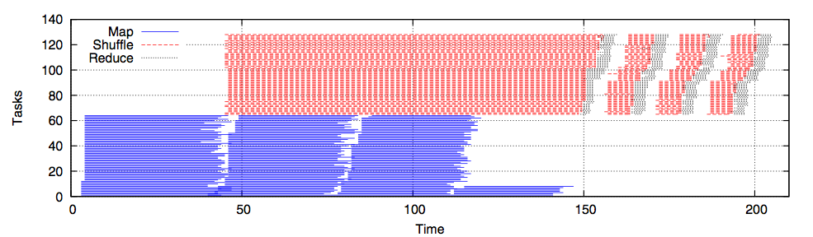
Why is Performance Modeling Difficult? (2)
WordCount with 64 map/64 reduce slots
Different resource allocations change completion time

Slide 14
Challenges
Job completion time is a complex non-linear function of allocated resources
Failures are common
Executing/profiling applications processing large datasets is time-consuming
Evaluating scheduling policies is labor intensive
Notes:
Paper references

Slide 15
Challenges
Job completion time is a complex non-linear function of allocated resources [ICAC11]
Failures are common [Middleware11]
Executing/profiling applications processing large datasets is time-consuming [LADIS11]
Evaluating scheduling policies can be labor intensive [Cluster11]
Notes:
Paper references

Slide 16
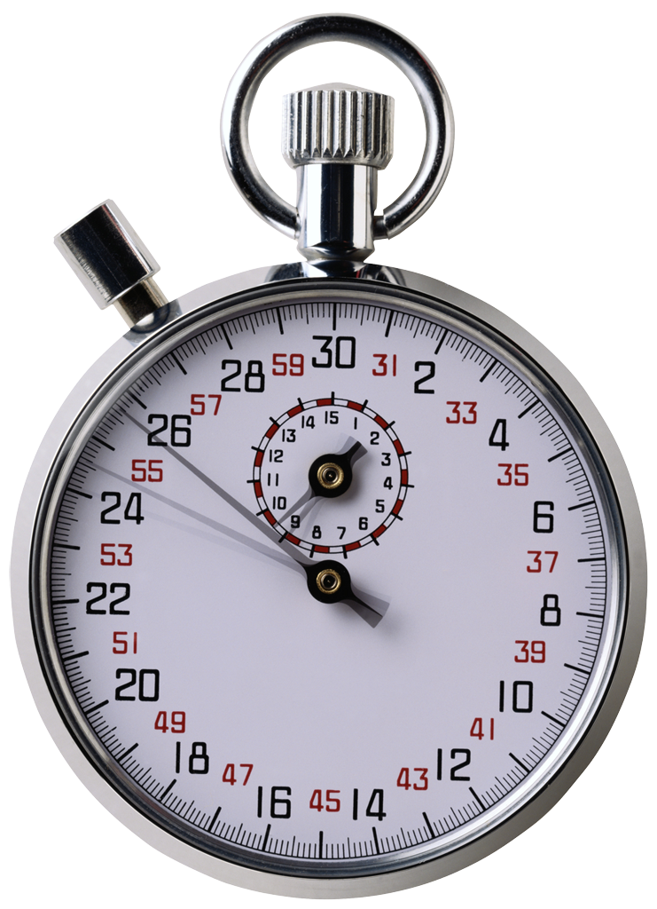
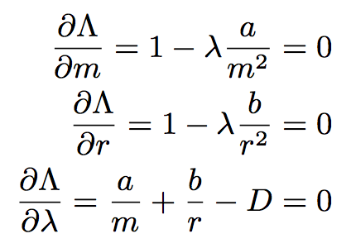

II) Performance Modeling Tools

Slide 17
Our Approach*
Most production jobs are executed routinely on new data sets
Measure the job characteristics of past executions
Each map and reduce task is independent of other tasks
Compactly summarize them in a job profile
Estimate the bounds of the job completion time (instead of trying to predict the exact job duration)
Estimate bounds on the duration of map, shuffle/sort, and reduce phases
* Abhishek Verma, Ludmila Cherkasova and Roy H. Campbell, "ARIA: Automatic Resource Inference and Allocation for MapReduce Environments". International Conference on Autonomic Computing (ICAC) 2011.

Slide 18

Caveats
“All models are wrong, some models are useful”
--- George Box
Map and Reduce task durations only depend on input dataset size
Jobs have been executed previously
Or can be profiled on smaller dataset
Network is not the bottleneck
New high bisection bandwidth datacenter topologies

Slide 19
Illustration
Sequence of tasks: 1 4 3 2 3 2 1
A
Makespan = 4
B
C
D
A different permutation: 3 1 2 3 2 1 4
A
B
Makespan = 7
C
D
Notes:
ABCD slots and permutation

Slide 20
Formalizing Makespan Bounds
Distributed task processing
assign each task to the slot with the earliest finishing time
Let T₁, T₂, …, T_{n} be the duration of n tasks processed by k slots
avg be the average duration and
max be the maximum duration of the tasks
Execution makespan can be approximated as
Lower bound is
Upper bound is
Notes:
avg on the other side, k slots

Slide 21
Compact Job Profile
Map Stage
M_{avg,max}
Reduce Stage
Shuffle/Sort_{avg,max}
AvgInputSize
Selectivity
Reduce_{avg,max}
Selectivity
AvgInputSize

Slide 22
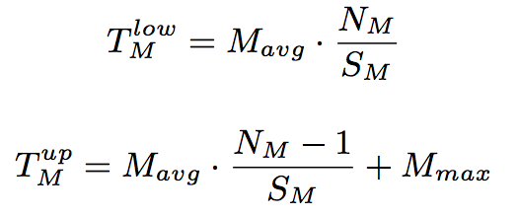
Lower & Upper Bounds of Job Completion Time
Two main stages: map and reduce stages
Map stage duration depends on:
N_{M}, S_{M} : number of map tasks and slots
Reduce stage duration depends on:
N_{R} , S_{R} : number of reduce tasks and slots
Reduce stage consists of :
Shuffle/sort phase
“First” wave is treated specially (non-overlapping with maps)
Remaining waves are “typical”
Reduce phase
Notes:
Change latex Nm/Sm

Slide 23

Experimental Setup
66 HP DL145 machines
Four 2.39 GHz cores
8 GB RAM
Two 160 GB hard disks
Two racks
Gigabit Ethernet
2 masters + 64 slaves
Workload
WordCount, Sort, Twitter, WikiTrends

Slide 24
Predicted vs. Measured Completion Time
Average of predicted bounds is within 10% of measured completion time

Slide 25
Scaling Factors*
Profiling job processing entire dataset can take too long
Build profile by executing on smaller dataset
Duration of map tasks not impacted
Larger data => greater number of map tasks
If number of reduce tasks kept constant,
Intermediate data processed per reduce task increases => longer durations
Reduce stage = shuffle + reduce phase
Shuffle duration depends on network performance
Reduce duration depends on reduce function and disk write speed
* Abhishek Verma, Ludmila Cherkasova and Roy H. Campbell, "SLO-Driven Right-Sizing and Resource Provisioning of MapReduce Jobs". Workshop on Large Scale Distributed Systems and Middleware (LADIS) 2011

Slide 26
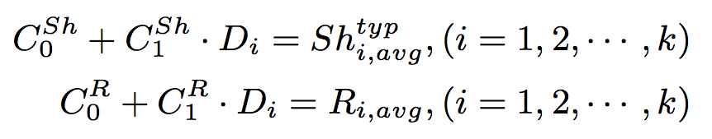
Scaling Factors Formalized
Perform k (> 2) experiments varying input dataset size
D_{i} = amount of intermediate data
Use linear regression to derive scaling factors
For shuffle and reduce phases separately
Per application

Slide 27
WordCount Scaling Factors
Linear regression fits phase durations with R² > 95%

Slide 28

Impact of Failures*
Commodity hardware => more failures
Performance depends on
Time of failure
Resources replenishable or not
Worker failure: faulty hard disk, process crash
Time of failure:
Map stage: restart all in-progress map tasks
Reduce stage: and all reduce tasks
* Abhishek Verma, Ludmila Cherkasova and Roy H. Campbell, "Resource Provisioning Framework for MapReduce Jobs with Performance Goals". International Middleware Conference, 2011.

Slide 29
Impact of Worker Failures

Slide 30
Simulation Framework*
Controlling resource allocations difficult
FIFO, Fair share, Capacity scheduler
Evaluating and comparing different schedulers and workload management strategies
Done using rules of thumb in an ad-hoc way
Goal: Build a simulator
Accurate, fast and useful
To replay collected real application traces
To play synthetic workloads
* Abhishek Verma, Ludmila Cherkasova and Roy H. Campbell, "Play it again, SimMR!". IEEE International Conference on Cluster Computing, 2011.

Slide 31
SimMR Design
Extracts number of map/reduce tasks, durations
Generates synthetic trace from task duration distribution
Different policies
MRProfiler
Synthetic
TraceGen
FIFO
Min
EDF
Max
EDF
Trace Database
Scheduling
Policy
Stores traces persistently
keyed by (job name, user)
Narrow interface: chooseNextMap/ReduceTask(jobQ)
Simulator Engine
Discrete event simulator replays tasks

Slide 32
Simulator Engine
Simulate at task level
Non-goal to simulate task trackers, disk, network,..
Maintain priority queue of
(eventTime, eventType, jobId)
Event types
Job arrival and departure
Map and reduce task arrival and departure
Map stage complete event
Discrete event simulation

Slide 33

Simulator Accuracy
SimMR faithfully replays traces (< 6.6% error)

Slide 34

Simulator Performance
SimMR can replay 2 week workload in 2 seconds
Notes:
Now that I have demonstrated the accuracy and performance of SimMR, let us proceed to see what we can do with it…

Slide 35

III) Applications

Slide 36
Applications
Deadline driven resource provisioning for a single MR job
Automatic Resource Inference and Allocation for shared environments
Benchmarking different hardware
Deadline scheduling of MR DAGs
Minimizing makespan of set of MR jobs
Notes:
Make graph

Slide 37
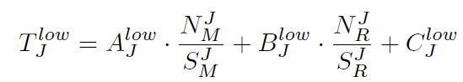
1. Deadline-driven resource provisioning
Many users require job completion time guarantees
No support from existing schedulers
Given a deadline T and job profile, find necessary amount of resources to complete the job within T.
Finding the set of minimal (map,reduce) slots to support the job execution within T:
Given number of map/reduce tasks
Find the number of map and reduce slots (S_{M}, S_{R}) such that S_{M}+S_{R} is minimum

Slide 38
Different bound curves
Find (S_{M}, S_{R}) using Lagrange multipliers

Slide 39
2. ARIA Design
Calculates (S_{M}, S_{R}) that need to be allocated to meet the job SLO
Profiles running or completed jobs
MySQL database stores past profiles keyed by (user, jobname)
Job Profiler
Slot Estimator
Profile Database
Listens for job submission, heartbeat events and schedules jobs EDF
SLO Scheduler
Keeps track of number of running map/reduce tasks and keeps them below allocated slots
Slot Allocator

Slide 40
ARIA Highlights
Computes required resource allocation given deadline and past job profile
Automatic
Preserves data locality
Robust against runtime variability
profiles the job while it is running
dynamic adjustments of the allocation

Slide 41



Three Pieces of the Puzzle
Job
Ordering
How many resources?
Allocating
spare resources
Notes:
Job Ordering
How to order jobs?
Tailoring amount of resources
How many slots to allocate?
Allocating spare resources
How to allocate and de-allocate spare resources?

Slide 42
Job Scheduling with Different Mechanisms*
Earliest Deadline First (EDF)
Does not require any job information
Min-EDF
Automatically extract job profiles from past executions
Compute and allocate minimum resources
Min-EDF-WC (Work Conserving)
Allocate any spare resources among running jobs
When new job arrives, compute if enough slots will be released in the future to satisfy current job
If not, cancel spare tasks of currently running jobs
* Abhishek Verma, Ludmila Cherkasova, Vijay S. Kumar and Roy H. Campbell, "Deadline-based Workload Management for MapReduce Environments”. Network Operations and Management Symposium (NOMS), 2012.

Slide 43
Comparing Different Mechanisms
Min-EDF-WC misses 2 times lesser job deadlines than Min-EDF
Min-EDF-WC leads to smaller job completion times than Min-EDF

Slide 44


3. Benchmarking Different Hardware
Enterprises replace datacenter machines
On average every 3 years
Given a set of hardware choices, which one should be picked?
How many machines of the new configuration are required for handling the same workload?
1) Run benchmark
on old cluster
3) Model
2) Run benchmark
on new cluster
4) Measure performance of
workload on old cluster
5) Estimate performance
on new cluster

Slide 45
Approach
Design a parameterized synthetic MapReduce application.
Break down task execution into phases
Map: read, map, collect, spill and merge
Reduce: shuffle, reduce write
Find a small set of these synthetic applications onto which any MapReduce workload can be projected
Using performance of the benchmarks on old and new hardware, estimate performance of any workload on new hardware

Slide 46
Distributed Benchmarking
Benchmark #1
Benchmark #9
Benchmark Specification
Input Data
M_{Inp} = 32, 64
Input Data
M_{Inp} = 32, 64
Param | Values
M_{Inp} | 32, 64
M_{Comp} | 1000, 4000
M_{Sel} | 0.2, 1.0, 2.0
R_{Comp} | 3000, 5000
R_{Sel} | 0.1, 0.5, 1.0
Map Stage
M_{Comp}= 1000,4000
M_{Sel} = 0.2
Map Stage
M_{Comp}= 1000,4000
M_{Sel} = 2.0
. . .
Reduce Stage
R_{Comp} = 3000, 5000
R_{Sel} = 0.1
Reduce Stage
R_{Comp} = 3000, 5000
R_{Sel} = 1.0
Output Data
Output Data

Slide 47
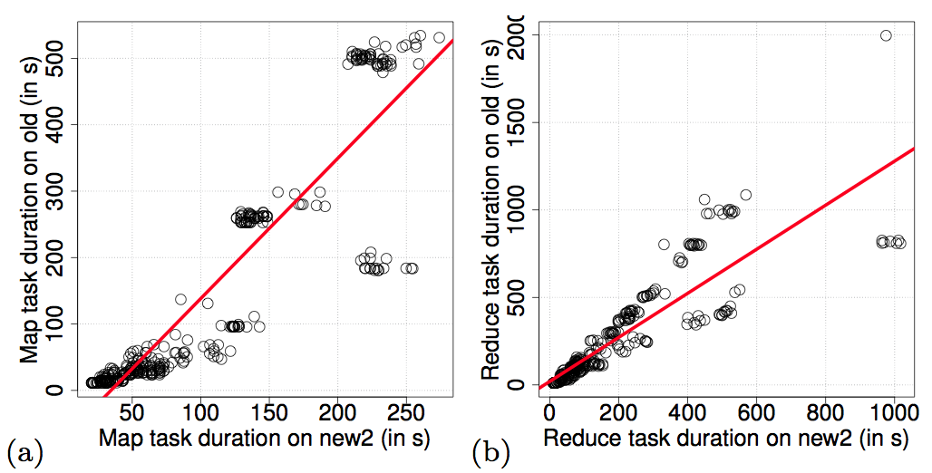
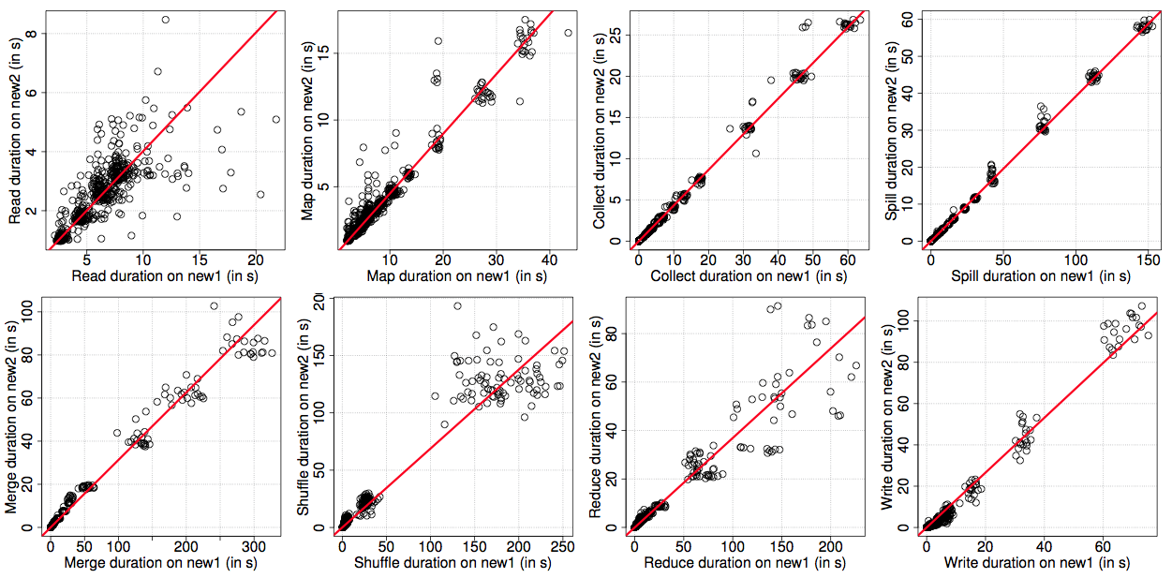

Slide 48
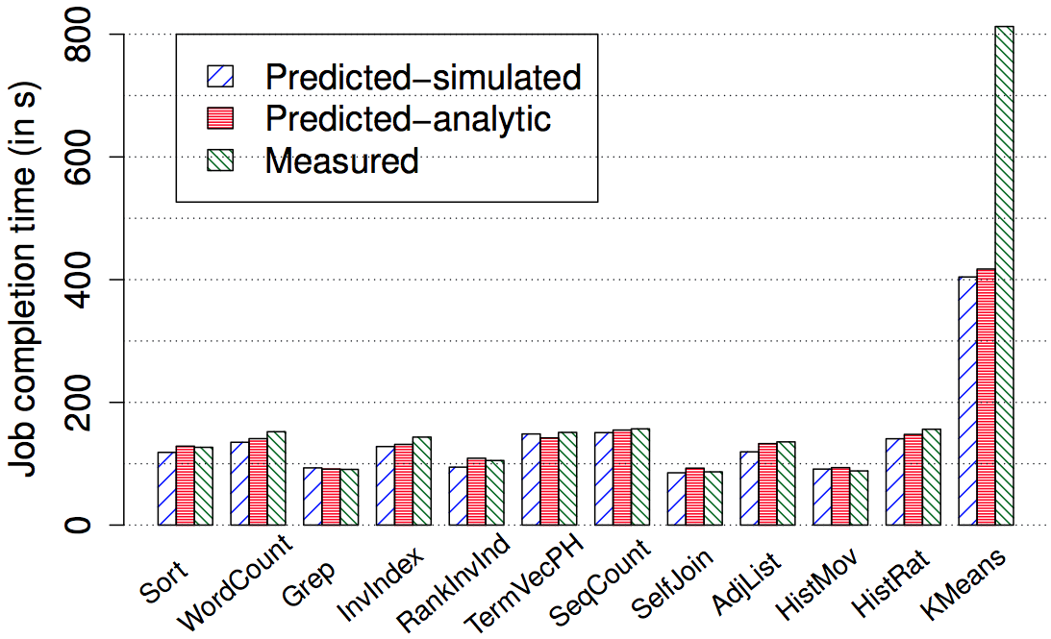
Prediction for new hardware
Difficult for CPU intensive jobs
Predictions within 6-10% of measured times

Slide 49
IV) Related Work
Schedulers
FIFO, Capacity, Fair-share, Quincy
FLEX, DP
Performance Modeling
Polo, Ganapathi, Phan
SteamEngine, Parallax
Simulators
MRPerf, GridSim, Mumak

Slide 50
Summary
Performance modeling techniques of MapReduce environments
Analytical models
Simulation
Experimental measurements
Service level objectives:
Deadline scheduling of single MR job
Automatic Resource Inference and Allocation
Comparing hardware choices

Slide 51
Future Work
Graduating in December 2012
Performance modeling of other systems
VM Clouds (OpenStack/EC2)
Networks
Machine learning
Big data for sciences
Online education
Questions? verma7@illinois.edu

Slide 53


Slide 54
Publications
Abhishek Verma, Ludmila Cherkasova, Vijay S. Kumar and Roy H. Campbell, "Deadline-based Workload Management for MapReduce Environments: Pieces of the Performance Puzzle". IEEE/IFIP Network Operations and Management Symposium (NOMS), Maui, Hawaii, April 2012.
Abhishek Verma, Ludmila Cherkasova, Vijay S. Kumar and Roy H. Campbell, "Three Pieces of the MapReduce Workload Management Puzzle". Work-in-progress Report, ACM Symposium on Operating Systems Principles (SOSP), Cascais, Portugal, October 2011.
Abhishek Verma, Ludmila Cherkasova and Roy H. Campbell, "Resource Provisioning Framework for MapReduce Jobs with Performance Goals". ACM/IFIP/USENIX 12th International Middleware Conference, Lisbon, Portugal, Dec 2011.
Abhishek Verma, Ludmila Cherkasova and Roy H. Campbell, "Play it again, SimMR!". IEEE International Conference on Cluster Computing (CLUSTER), Austin, Texas, Sept 2011.
Abhishek Verma, Ludmila Cherkasova and Roy H. Campbell, "SLO-Driven Right-Sizing and Resource Provisioning of MapReduce Jobs". Workshop on Large Scale Distributed Systems and Middleware (LADIS) in conjunction with VLDB, Seattle, Washington, Sept 2011.
Abhishek Verma, Ludmila Cherkasova and Roy H. Campbell, "ARIA: Automatic Resource Inference and Allocation for MapReduce Environments". International Conference on Autonomic Computing (ICAC), Karlsruhe, Germany, June 2011.
Abhishek Verma, Nicolas Zea, Brian Cho, Indranil Gupta and Roy H. Campbell, "Breaking the MapReduce Stage Barrier". IEEE International Conference on Cluster Computing (CLUSTER), Heraklion, Greece, Sept, 2010.
Abhishek Verma, Xavier Llorà Shivaram Venkataram, David E. Goldberg and Roy H. Campbell, "Scaling eCGA Model Building via Data-Intensive Computing". IEEE Congress on Evolutionary Computation (CEC), Barcelona, Spain, July 2010.
Abhishek Verma, Xavier Llorà David E. Goldberg and Roy H. Campbell, "Scaling Genetic Algorithms using MapReduce". Ninth International Conference on Intelligent Systems Design and Applications (ISDA), pp.13-18, Pisa, Italy, Nov, 2009.
Reza Farivar, Abhishek Verma, Ellick Chan and Roy H. Campbell. "MITHRA: Multiple data Independent Tasks on a Heterogeneous Resource Architecture". IEEE International Conference on Cluster Computing and Workshops (CLUSTER), pp.1-10, New Orleans, LA, Sept, 2009.

Slide 55
Backup Slides

Slide 56
3. Deadline Scheduling of MapReduce DAGs
Complex analysis programs expressed as DAGs
Pig, Hive, Dryad
How to enable accurate resource prediction?
Naïve application of MR performance model
Higher predicted completion times
Stage pipelining and concurrent jobs
Chicken and egg problem
Resource Allocation -> Completion time -> Allocation
More accurate modeling is needed

Slide 57
Solving the Chicken and Egg problem

Slide 58
4. Minimizing Makespan of Set of MR Jobs
Order of MR jobs can affect Makespan
Given a set of MapReduce jobs, determine the order in which they should be executed to minimize the Makespan.
Makespan = 42
Makespan = 42
20
2
20
2
J₁:
J₁:
Makespan = 24
2
2
20
20
J₂:
J₂:

Slide 59
Optimizing Batch Schedule
In 1953, Johnson designed optimal O(n log n) algorithm for job shop scheduling
Load balancing MR job consisting of multiple tasks on multiple machines is NP hard
Johnson’s algorithm is sub-optimal if jobs don’t consume all resources in the cluster
Bimodal distribution
O(n² log n log M) heuristic for partitioning resources into pools

Slide 60
Simulating Different Algorithms

